Slide 1

Library Management System (SQL Project) by Ashok T
This project presents a normalized relational database design for a multi-branch library system, implemented with SQL and illustrated with sample analytical queries. The deck guides you from objectives through data modeling and practical queries.

Slide 2

Introduction
Libraries store diverse data about books, authors, borrowers, loans, and branches. Manual or spreadsheet-based management causes inefficiency, duplicated records, and integrity problems. A relational database enforces structure, constraints, and relationships so librarians can reliably find and manage resources.
This presentation explains the design decisions and demonstrates key SQL queries for common operational and analytical tasks.

Slide 3

Objective
Primary goals:
Design an intuitive relational schema for library operations across multiple branches.
Enforce data integrity using keys and constraints (PKs, FKs, unique constraints).
Support efficient tracking of books, individual copies, loans, and borrowers.
Provide example SQL queries that demonstrate real-world reporting and investigation.

Slide 4
Problem Statement
Many libraries experience redundancy (duplicate book/author records), inconsistent borrower information, and difficulties tracking individual copies across branches. The goal is to replace ad-hoc systems with a unified relational database that:
1) eliminates redundancy via normalization,
2) defines clear relationships between entities, and
3) enables automation of loan management and reporting to reduce human error.

Slide 5
Overview of Data
tbl_book.csv
tbl_book_authors.csv
tbl_library_branch.csv
Primary book metadata: BookID (PK), Title, ISBN, PublisherID, PublicationYear, Category.
Author association table: BookAuthorID (PK), BookID (FK), AuthorName — supports many-to-many if modeled further.
Branches: BranchID (PK), BranchName, Location, ContactInfo.
tbl_publisher.csv
Publisher details: PublisherID (PK), Name, Address, Contact.
tbl_book_copies.csv
tbl_borrower.csv
tbl_book_loans.csv
Copies: CopyID or composite (BookID, BranchID), No_Of_Copies — tracks how many physical copies each branch holds.
Borrowers: CardNo (PK), BorrowerName, Address, Phone, Email — unique card numbers identify patrons.
Loans: LoanID (PK), BookID (FK), BranchID (FK), CardNo (FK), DateOut, DueDate, DateIn — core for circulation tracking.

Slide 6
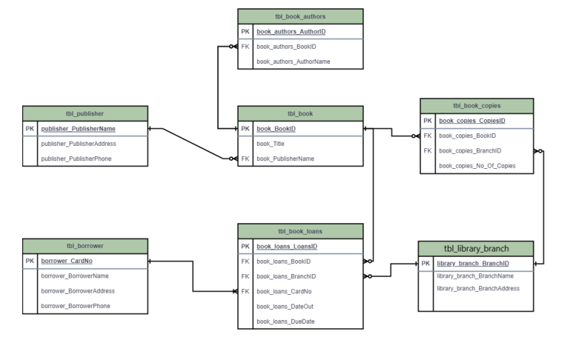
Data Model Diagram
The diagram clarifies cardinality and where foreign keys enforce relationships. Normalization reduces duplicated publisher and author data; copies are tied to both Book and Branch to represent inventory per branch.

Slide 7
Query 1 — Book Copies at Sharpstown
This query finds how many copies of the title "The Lost Tribe" are available specifically at the Sharpstown branch. It joins copies with books and branches to constrain results by title and branch name. Use this to answer circulation and stocking questions for branch-level procurement.
SELECT lb.library_branch_BranchName, b.book_Title, bc.book_copies_No_Of_Copies FROM tbl_book_copies bc JOIN tbl_book b ON bc.book_copies_BookID = b.book_BookID JOIN tbl_library_branch lb ON bc.book_copies_BranchID = lb.library_branch_BranchID WHERE b.book_Title = 'The Lost Tribe' AND lb.library_branch_BranchName = 'Sharpstown';
Notes: Ensure Title matching handles case or whitespace; consider using b.book_Title ILIKE '%Lost Tribe%' for fuzzy matches in some RDBMS.

Slide 8
Query 2 — Book Copies per Branch
This query lists the number of copies of 'The Lost Tribe' across all branches. It supports inventory audits and redistribution planning. It aggregates per branch when multiple copy records exist per branch for the same book.
Tip: For consolidated counts,
wrap bc.book_copies_No_Of_Copies with SUM(...) and add GROUP BY lb.library_branch_BranchName,
b.book_Title.
SELECT lb.library_branch_BranchName, b.book_Title, bc.book_copies_No_Of_Copies FROM tbl_book_copies bc
JOIN tbl_book b ON bc.book_copies_BookID = b.book_BookID
JOIN tbl_library_branch lb ON bc.book_copies_BranchID = lb.library_branch_BranchID WHERE b.book_Title = 'The Lost Tribe';

Slide 9

Query 3 — Borrowers Without Loans
Identify registered borrowers who currently have no active loans. This is useful for engagement campaigns and cleaning up stale borrower accounts. The LEFT JOIN/IS NULL pattern reliably finds rows in tbl_borrower without matching current loan records.
SELECT br.borrower_BorrowerName, br.borrower_CardNo FROM tbl_borrower br
LEFT JOIN tbl_book_loans bl ON br.borrower_CardNo = bl.book_loans_CardNo
WHERE bl.book_loans_CardNo IS NULL;
Consider filtering loans by DateIn IS NULL if table keeps historical loans—this ensures identification of borrowers with no currently checked-out books.

Slide 10

Query 4 — Due Books at Sharpstown
Retrieve all books due on 2018-03-02 at the Sharpstown branch, including borrower contact details for reminders or hold processing. This query joins loans to books, borrowers, and branches to produce actionable circulation tasks for staff.
SELECT b.book_Title, br.borrower_BorrowerName, br.borrower_BorrowerAddress, bl.book_loans_DueDate FROM tbl_book_loans bl JOIN tbl_book b ON bl.book_loans_BookID = b.book_BookID JOIN tbl_borrower br ON bl.book_loans_CardNo = br.borrower_CardNo
JOIN tbl_library_branch lb ON bl.book_loans_BranchID = lb.library_branch_BranchID
WHERE lb.library_branch_BranchName = 'Sharpstown' AND bl.book_loans_DueDate = '2018-03-02';
Operational tips: Use this output to generate reminder emails/SMS. If multiple items per borrower exist, group results by borrower for consolidated notifications.

Slide 11
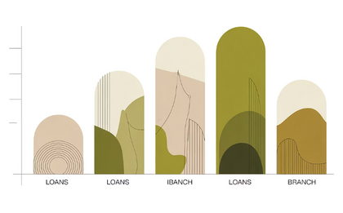
Query 5 — Books Loaned per Branch
Objective: Retrieve the total number of books loaned for each library branch to measure circulation per location. SQL (final):
SELECT lb.library_branch_BranchName, COUNT(bl.book_loans_LoansID) AS Total_Books_Loaned
FROM tbl_library_branch lb LEFT JOIN tbl_book_loans bl ON lb.library_branch_BranchID = bl.book_loans_BranchID
GROUP BY lb.library_branch_BranchName;
Notes: LEFT JOIN preserves branches with zero loans so administrators can easily spot inactive locations. Use an index on book_loans_BranchID for performance on large loan tables.

Slide 12



Query 6 — Active Borrowers (More Than 5 Books)
Objective: Identify borrowers who currently have more than five books checked out — useful for targeted communications or policy enforcement. SQL (final):
SELECT br.borrower_BorrowerName, br.borrower_BorrowerAddress, COUNT(bl.book_loans_BookID) AS Books_Checked_Out FROM tbl_borrower br
JOIN tbl_book_loans bl ON br.borrower_CardNo = bl.book_loans_CardNo
GROUP BY br.borrower_CardNo, br.borrower_BorrowerName, br.borrower_BorrowerAddress
HAVING COUNT(bl.book_loans_BookID) > 5;
Notes: Grouping by CardNo ensures correct aggregation. Include name and address in GROUP BY or select them via a subquery to satisfy SQL strictness. Consider adding current_due_date filters to capture only active (not returned) loans.

Slide 13
Query 7 — Stephen King Books at Central Branch
Objective: Get a list of Stephen King titles and the number of copies available at the Central branch to support collection planning and inter-branch transfers. SQL (final):
SELECT b.book_Title, lb.library_branch_BranchName, bc.book_copies_No_Of_CopiesFROM tbl_book b
JOIN tbl_book_authors ba ON b.book_BookID = ba.book_authors_BookID
JOIN tbl_book_copies bc ON b.book_BookID = bc.book_copies_BookID
JOIN tbl_library_branch lb ON bc.book_copies_BranchID = lb.library_branch_BranchID
WHERE ba.book_authors_AuthorName = 'Stephen King' AND lb.library_branch_BranchName = 'Central';
Notes: This query relies on accurate author-name normalization. Prefer an authors table with author IDs to avoid mismatches from name variations. Use the reserved 20% right-side area for an output image showing a small table or thumbnail list of titles with counts.

Slide 14
Analysis & Insights
Key findings from the queries: - Sharpstown branch shows highest circulation; prioritize supply and staffing adjustments there. - Several titles are available only at specific branches, indicating potential inequity in access — consider redistribution or inter-branch loan policies. - Inactive borrowers and borrowers with high outstanding loans were identified; automate follow-ups to improve turnover. - These insights enable branch-level resource optimization: targeted acquisitions, staffing, and scheduling.
Resource Allocation
Access Equity
Operational Efficiency
Redirect popular titles and additional copies to high-circulation branches to reduce wait times and improve user satisfaction.
Implement inter-branch transfer workflows and short-term loans to ensure patrons can access titles regardless of location.
Use active-borrower data to design reminder cadence and to detect potential account abandonment or abuse.

Slide 15

Conclusion — What We Built and Why It Matters
Summary: - Implemented a normalized SQL library database that enforces referential integrity and reduces redundancy across books, authors, copies, borrowers, and branches. - Analytical queries provided operational intelligence: branch circulation, heavy borrowers, and author-specific inventory at branches. - These outcomes make day-to-day library operations more data-driven and scalable.
Impact
Recommendations
Improved collection strategy, more equitable access, and higher resource utilization.
Adopt regular reporting, index frequently queried columns, and normalize author/branch identifiers to prevent data drift.

Slide 16




Future Enhancements & Roadmap
Proposed next steps to evolve the system: - Add triggers to automatically update book_copies_No_Of_Copies when loans are created or returned to ensure real-time accuracy. - Implement role-based access control so librarians and admins have appropriate permissions for updates, reporting, and data exports. - Build late-fee calculation and notification mechanisms (email/SMS) to improve returns and reduce loss. - Integrate analytics dashboards (BI) and QR-code-based tracking for faster circulation workflows and contactless checkouts.
Automated Triggers
Maintain counts and data integrity automatically at transaction time.
Roles & Security
Protect sensitive borrower data and limit destructive operations.
Dashboards
Operational dashboards that surface trends, overdue items, and branch KPIs in real time.

Slide 17
Thank You — Questions?

